Slide 1
Discrete Mathematics (CSC 1204)
5.2 The Pigeonhole Principle
3.8 Matrices

Slide 2
The Pigeonhole Principle
If there are more pigeons than pigeonholes, then there must be at least one pigeonhole with at least two pigeons in it.
Theorem 1: (The Pigeonhole Principle) If k is a positive integer and k+1 or more objects are placed into k boxes, then there is at least one box containing two or more of the objects.
Proof (by contraposition)
Also called the Dirichlet drawer principle

Slide 3
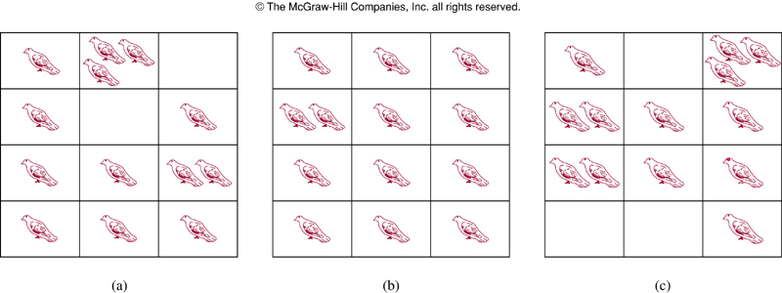
FIGURE 1 : There Are More Pigeons Than Pigeonholes
Notes:
p:\msoffice\My Projects\Rosen 6e 2007\Imagebank\JPEGs07-24-06\ch05\jpeg\05_2_01.jpg

Slide 4
The Pigeonhole Principle
The Pigeonhole Principle can be used to prove a useful corollary about functions.
Corollary 1: A function from a set with k+1 or more elements to a set with k elements is not one-to-one.
Example 1 (p. 348): Among any group of 367 people, there must be at least two with the same birthday, because there are only 366 possible birthdays.

Slide 5
The Generalized Pigeonhole Principle
Theorem 2 (The Generalized Pigeonhole Principle): If N objects are placed into k boxes, then there is at least one box containing at least ⎡N/k⎤ objects.
Example 5 (p.349): Among 100 people there are at least ⎡100/12⎤ = 9 who were born in the same month.

Slide 6
Example 6
What is the minimum number of students required in a discrete mathematics class to be sure that at least six will receive the same grade, if there are five possible grades, A, B, C, D, and F?
Solution: The minimum number of students needed to ensure that at least six students receive the same grade is the smallest integer N such that ⎡N /5⎤ = 6.
The smallest such integer is N = 5.5 + 1 = 26.
Note: ⎡N/5⎤ ≥ 6, or, N ≥ 5.5 +1, or, N ≥ 26
N _{smallest} = 26

Slide 7
Exercise 31 (page 353)
Exercise 31: There are 38 different time periods during which classes at a university can be scheduled. If there are 677 different classes, how many different rooms will be needed?
Solution: Try it out!

Slide 8
Solution of Exercise 31 (page 353)
Solution: Thinks that the 38 time periods are the
pigeonholes, and the 677 classes are the pigeons.
By the generalized pigeonhole principle there is some
time period in which at least ⎡677 /38⎤ = 18 classes are
meeting.
Since each class must meet in a different room, we need
18 rooms.

Slide 9
3.8 Matrices

Slide 10
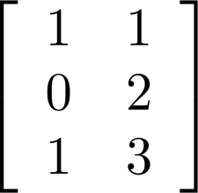
Matrix
Definition 1: A matrix is a rectangular array of numbers. A matrix with m rows and n columns is called an m× n matrix.
The plural of matrix is matrices
A matrix with the same number of rows as columns is called a square (or square matrix)
Two matrices are equal if they have the same number of rows and the same number of columns and the corresponding entries in every position are equal.
is a 3× 2 matrix

Slide 11
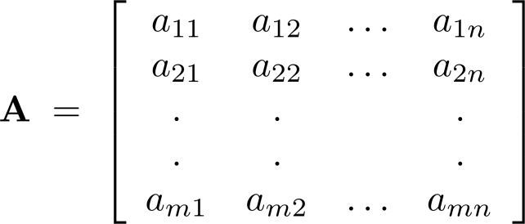
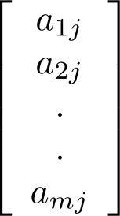
Notation
Let m and n be positive integers and let
The ith row of A is the 1× n matrix [a_{i1}, a_{i2},…,a_{in}]. The jth column of A is the m× 1 matrix:
The (i,j)th element or entry of A is the element a_{ij}.
We can use A = [a_{ij} ] to denote the matrix with its (i,j)th element equal to a_{ij}.

Slide 12
Matrix Arithmetic : Addition of two Matrices
Definition 3: Let A= [a_{ij}] and B=[b_{ij}] be m×n matrices. The sum of A and B, denoted by A+B, is the m×n matrix that has a_{ij}+b_{ij} as its (i,j)th element.
In other words , A + B = [a_{ij} + b_{ij}]

Slide 13
Matrix Arithmetic: Addition of two Matrices
The sum of two matrices of the same size is obtained by adding elements in the corresponding positions.
The subtraction of two matrices of the same size is obtained by subtracting elements in the corresponding positions
Only matrices with the same dimensions can be added and subtracted. The resulting matrix has the same dimension of the two matrices being added or subtracted.
Note: Matrices of different sizes cannot be added/subtracted

Slide 14
Example of Matrix Addition
Add the corresponding elements in each matrix

Slide 15
Example of Matrix Addition: Example 2 (p.258)
Find out the sum of the following two matrices A and B.

Slide 16
Example of Matrix Addition: Example 2 (p.258)
Solution:

Slide 17
Matrix Arithmetic: Product of two Matrices
Definition 4: Let A be m× k matrix and B be k× n matrix. The product of A and B, denoted by AB, is the m× n matrix with its (i,j)th element equal to the sum of the products of the corresponding entries from the ith row of A and the jth column of B.
In other words,
If AB = [c_{ij}], then c_{ij} =a_{i1}b_{1j}+a_{i2}b_{2j}+…+a_{ik}b_{kj}.
Note: A product of two matrices is defined only when the number of columns in the first matrix equals the number of rows of the second matrix.

Slide 18
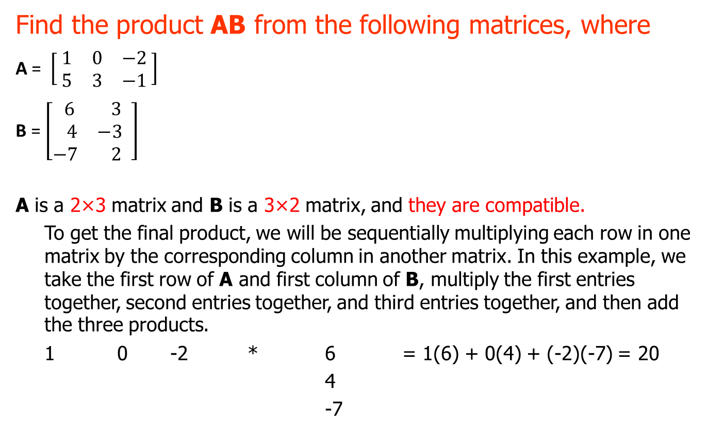
Product of two Matrices: Example
Find the product AB from the following matrices, where
A = $\left[\begin{matrix} 1 & 0 & −2 \\ 5 & 3 & −1\end{matrix} \right]$
B = $\left[\begin{matrix} 6 & 3 \\ 4 & −3 \\ −7 & 2\end{matrix} \right]$
A is a 2×3 matrix and B is a 3×2 matrix, and they are compatible.
To get the final product, we will be sequentially multiplying each row in one matrix by the corresponding column in another matrix. In this example, we take the first row of A and first column of B, multiply the first entries together, second entries together, and third entries together, and then add the three products.
1 0 -2 * 6 = 1(6) + 0(4) + (-2)(-7) = 20
4
-7

Slide 19
This sum is one of the entries in the product matrix AB; in fact, being the product
of row 1 of A and column 1 of B, it is the (1,1)-entry in AB.
Column 1
↓
Row 1 → 20 #
# #
Then we continue in like manner; we multiply row 1 of A by column 2 of B.
1 0 -2 * 3 = 1(3) + 0(-3) + (-2)(2) = -1
-3
2
And its position in matrix AB is
Column 2
↓
20 -1 ← Row 1
# #

Slide 20
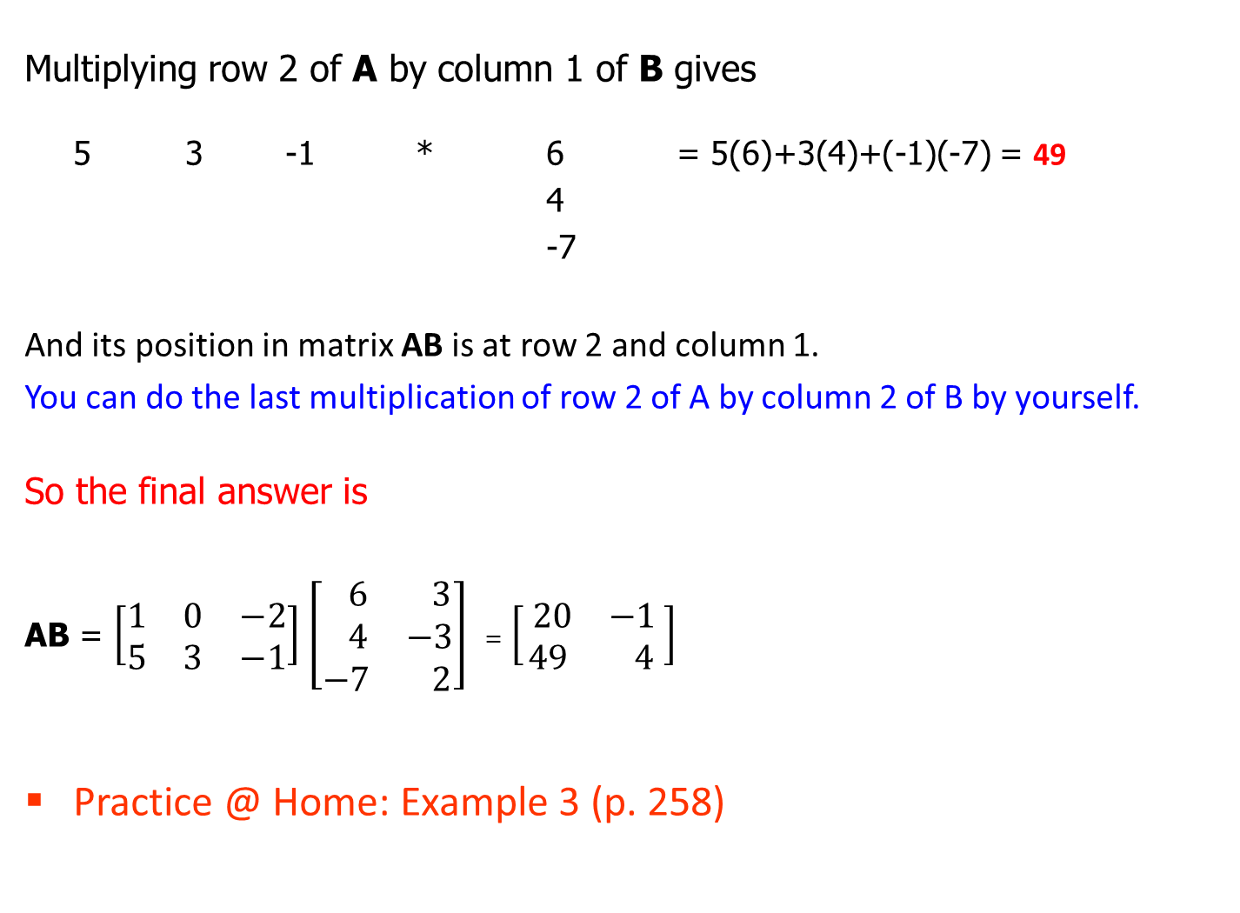
Multiplying row 2 of A by column 1 of B gives
5 3 -1 * 6 = 5(6)+3(4)+(-1)(-7) = 49
4
-7
And its position in matrix AB is at row 2 and column 1.
You can do the last multiplication of row 2 of A by column 2 of B by yourself.
So the final answer is
AB = $\left[\begin{matrix}1 & 0 & −2 \\ 5 & 3 & −1\end{matrix}\right]$ $\left[\begin{matrix} 6 & 3 \\ 4 & −3 \\ −7 & 2\end{matrix}\right]$ = $\left[\begin{matrix} 20 & −1 \\ 49 & 4\end{matrix}\right]$
Practice @ Home: Example 3 (p. 258)

Slide 21
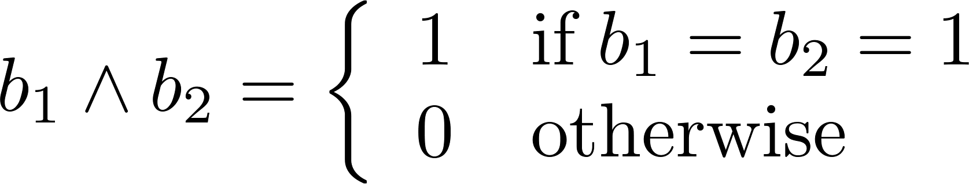
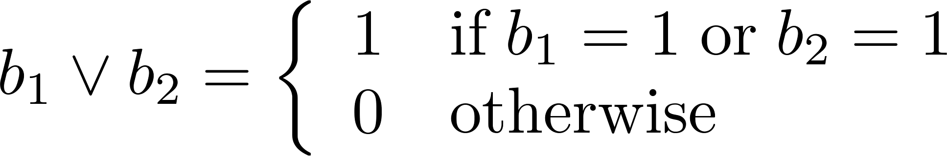
Zero-One Matrices
Definition: A matrix with entries that are either 0 or 1 is called zero-one matrix.
Algorithms operating on discrete structures represented by zero-one matrices are based on Boolean arithmetic defined by the following Boolean operations:

Slide 22
Join and Meet of Zero-One Matrices
Definition: Let A = [a_{ij}] and B = [b_{ij}] be an m × n zero-one matrices.
The join of A and B is the zero-one matrix with (i,j)th entry a_{ij} ∨ b_{ij}. The join of A and B is denoted by A ∨ B.
The meet of A and B is the zero-one matrix with (i,j)th entry a_{ij} ∧ b_{ij}. The meet of A and B is denoted by A ∧ B.
Note: These operations(join and meet) are only possible when A and B have the same size, just as in the case of matrix addition.

Slide 23
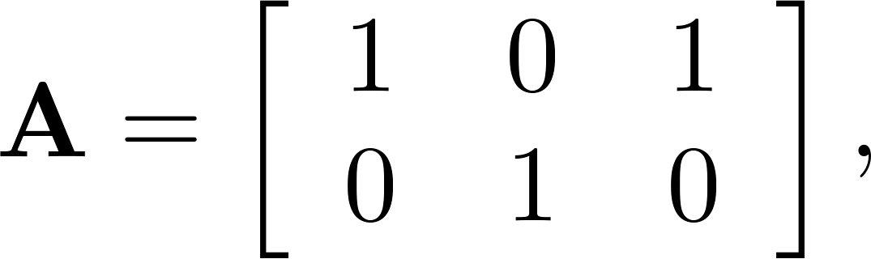
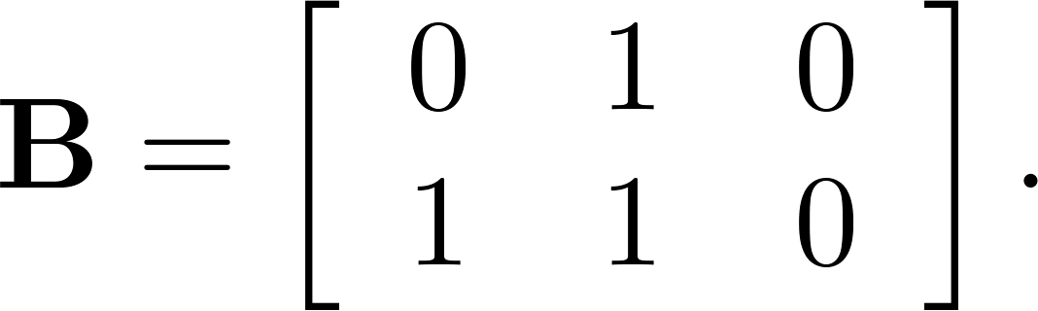
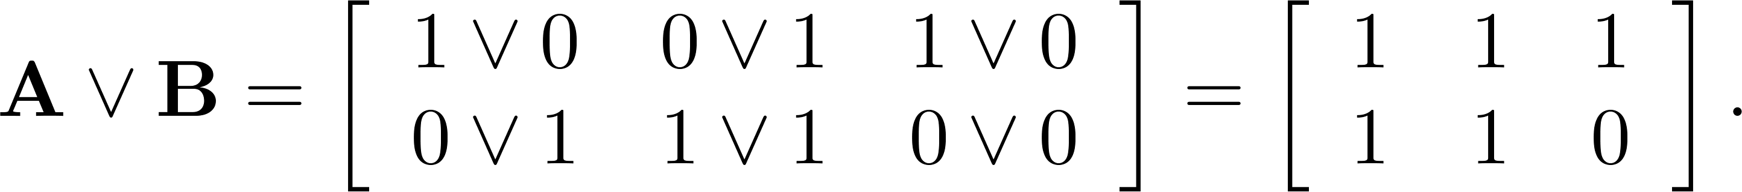
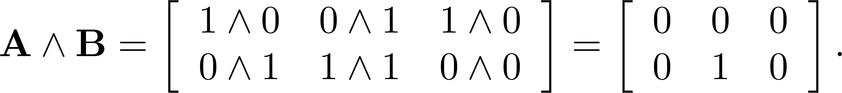
Join and Meet of Zero-One Matrices: Example
Example 9 (p. 262): Find the join and meet of the zero-one
matrices A and B.
Solution: The join of A and B is
The meet of A and B is

Slide 24
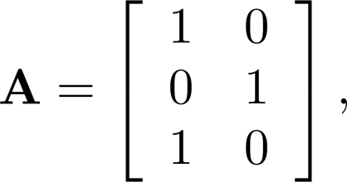
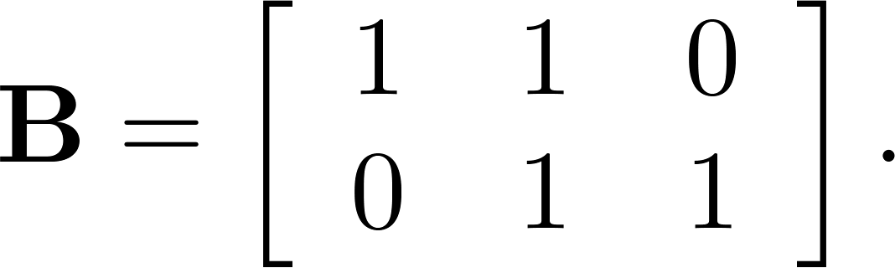
Boolean Product of Zero-One Matrices
Definition: Let A = [a_{ij}] be an m× k zero-one matrix and
B = [b_{ij}] be a k× n zero-one matrix.
The Boolean product of A and B, denoted by A ⊙ B, is
the m× n zero-one matrix with(i,j)th entry c_{ij} where c_{ij} = (a_{i1} ∧ b_{1j})∨ (a_{i2} ∧ b_{2j}) ∨ … ∨ (a_{ik} ∧ b_{kj})
Example 9 (p.262): Find the Boolean product of A and
B, where

Slide 25
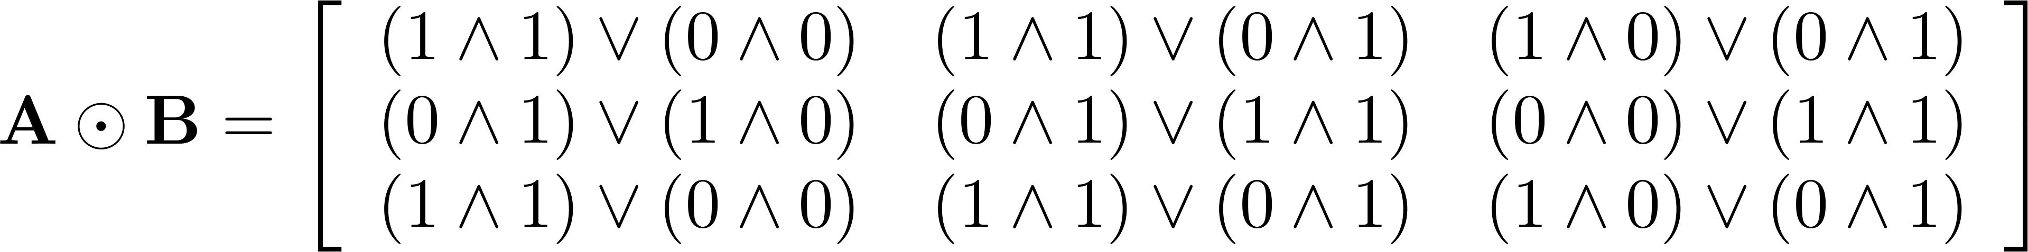
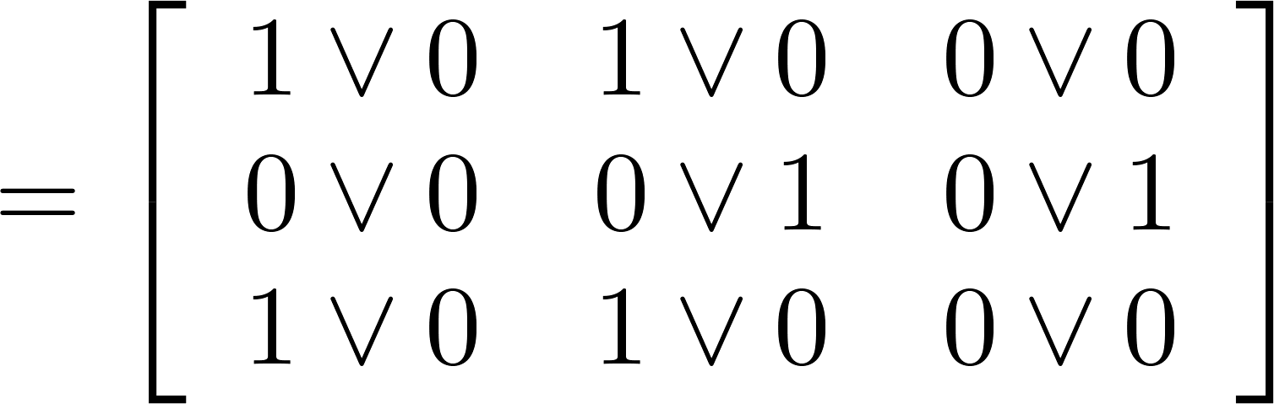
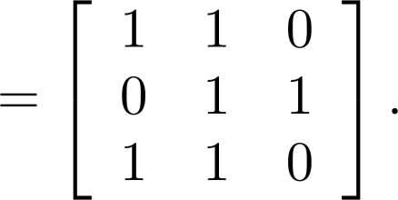
Solution of Example 9 (p.262)
The Boolean Product, A ⊙ B is given by

Slide 26
Practice @ Home
Relevant Odd-Numbered Exercises

